Slide 1
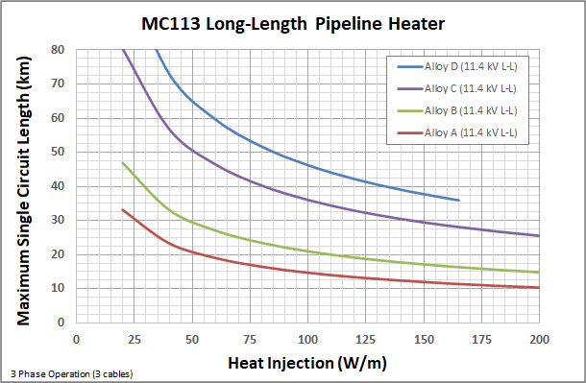
Pipeline Data Sheet – MC113
A
B
C
Internal
Conductor
Transition
Conductor
Compressed MgO
Sheath
Salamander Solutions mineral insulated heater cables are manufactured using a continuous methodology, which enables long-length capability. Our patented manufacturing techniques produce mineral insulated cables which are unparalleled in performance, highly robust, and capable of delivering medium voltage power at long-lengths and high temperatures.
With continuous lengths of more than 2 km, external splicing can be minimized or eliminated altogether, greatly improving the reliability of the overall system. Internal transitions of the conductor allow for targeted heating in applications.
Each Salamander mineral insulated cable is designed and fabricated based on the heating requirements for the given application. A complete suite of high integrity cable and end connectors are available.
Physical Data
Cable Diameter* | 1.13-inches (28.7 mm)
Sheath Material | Various Alloys
Conductor Material | CuNi Alloys
Insulation Material | Compressed MgO
Weight* | 3.70 kg/m
Min Bend Radius* | 1.0 meter
Pulling Tension* | 5 metric tons
*single cable
Pipeline and Subsea Applications:
Pipeline Heating
Molten Sulphur pipelines and transfer lines
Bitumen / heavy oil lines
High viscosity / waxy crude lines
Subsea and Deepwater Flowline Heating
Flow assurance: hydrate / wax prevention and mitigation
Extended reach capability: access stranded reserves from existing hosts
Any long-length or high intensity heating requirements in challenging conditions.
Operating Data
Max Operating Voltage (L-L) | 11.4 kV*
Max Current | 300 A
Max Temperature (Continuous) | 650 °C (1200 °F)
Max Temperature (Intermittent) | 700 °C (1300 °F)
Min Storage Temperature | -65 °C (-85 °F)
Min Installation Temperature | -35 °C (-30 °F)
*higher voltage rating than in-well application due to lower temperature operation
05-2020

Slide 2
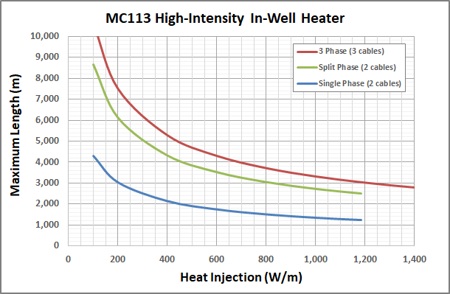
In-Well Data Sheet – MC113
A
B
C
Internal
Conductor
Transition
Conductor
Compressed MgO
Sheath
Salamander Solutions mineral insulated heater cables are manufactured using a continuous methodology, which enables long-length capability. Our patented manufacturing techniques produce mineral insulated cables which are unparalleled in performance, highly robust, and capable of delivering medium voltage power at long-lengths and high temperatures.
With continuous lengths of more than 2 km, external splicing can be minimized or eliminated altogether, greatly improving the reliability of the overall system. Internal transitions of the conductor allow for targeted heating in applications.
Each Salamander mineral insulated cable is designed and fabricated based on the heating requirements for the given application. A complete suite of high integrity cable and end connectors are available.
Physical Data
Cable Diameter* | 1.13-inches (28.7 mm)
Sheath Material | Various Alloys
Conductor Material | CuNi Alloys
Insulation Material | Compressed MgO
Weight* | 3.70 kg/m
Min Bend Radius* | 1.0 meter
Pulling Tension* | 5 metric tons
*single cable
Applications:
In-Well Heating
Increases production in “cold flow” heavy oil wells
Accelerates production and improves SAGD / CSS performance
Provides flow assurance for waxy wells
Enables in situ conversion of kerogen or in situ upgrading of heavy oil
Can address any long-length or high intensity heating requirements in challenging conditions.
Operating Data
Max Operating Voltage (L-L) | 8.66 kV
Max Current | 300 A
Max Temperature (Continuous) | 650 °C (1200 °F)
Max Temperature (Intermittent) | 700 °C (1300 °F)
Min Storage Temperature | -65 °C (-85 °F)
Min Installation Temperature | -35 °C (-30 °F)
05-2020

